Slide 1

Algorithmic Bias

Slide 2
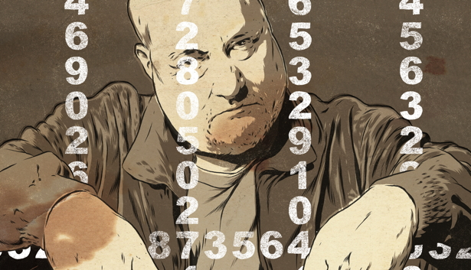

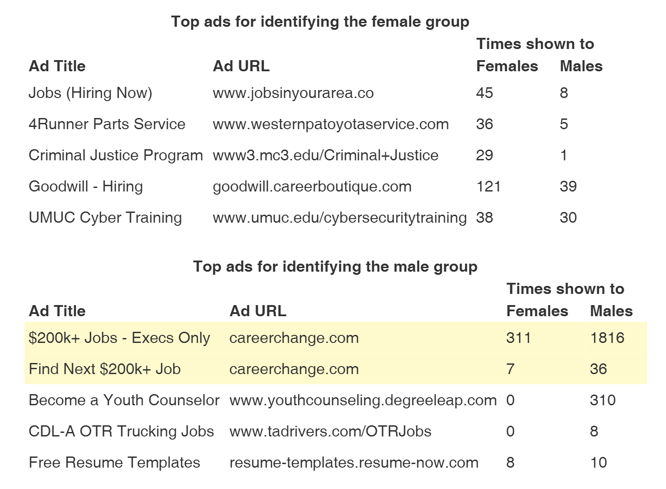
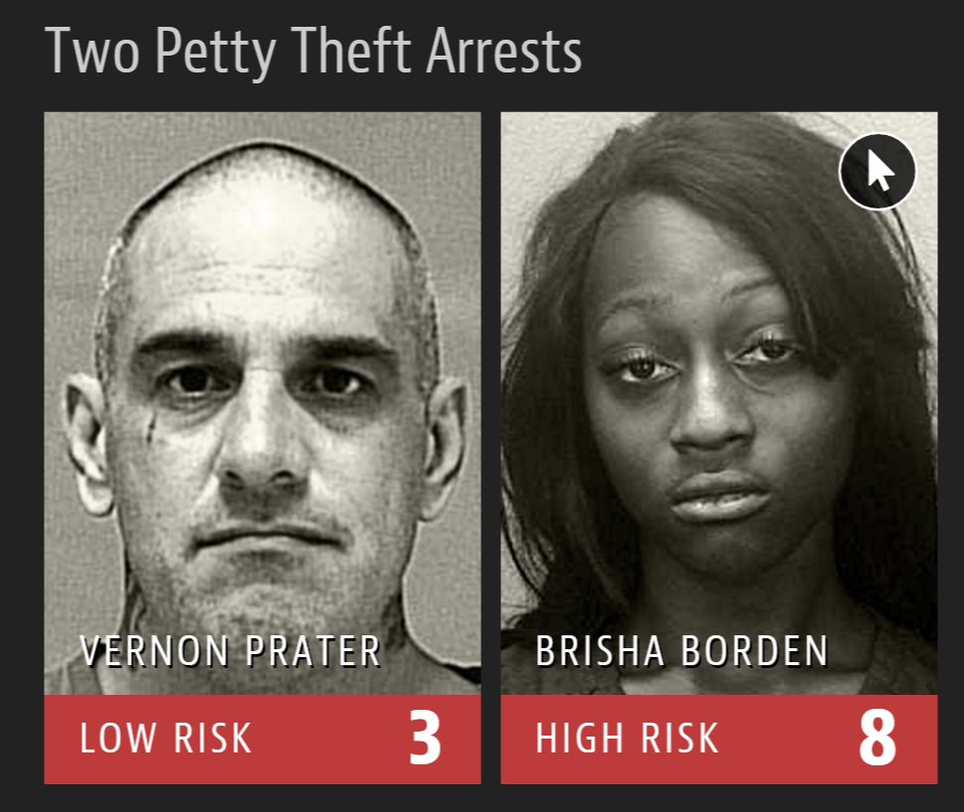
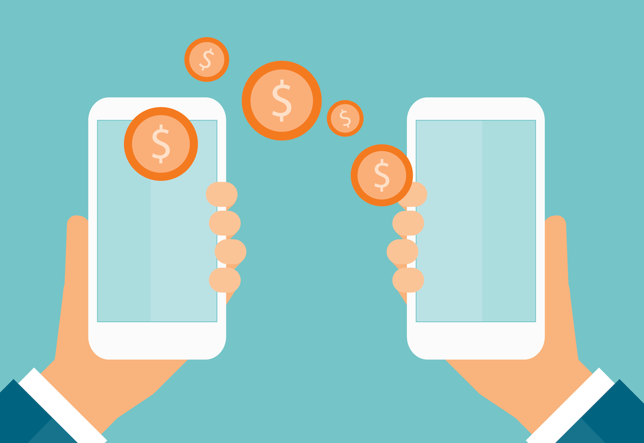
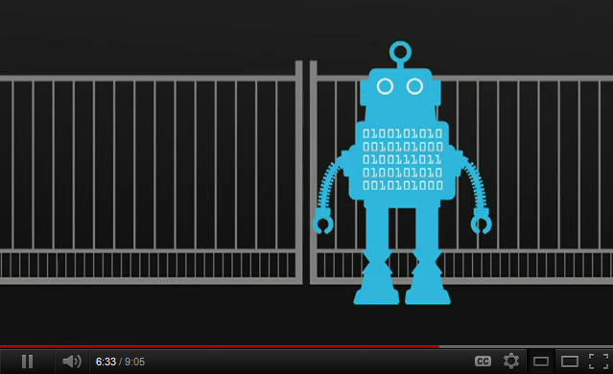

Algorithm Bias
Notes:
https://www.technologyreview.com/s/608248/biased-algorithms-are-everywhere-and-no-one-seems-to-care/
Algorithmic hiring: http://fortune.com/2017/05/19/ai-changing-jobs-hiring-recruiting/ including NL to analyze what they say
Algorithmic hiring in health care: https://www.arena.io/
EAR
Digital lending: http://www.npr.org/sections/alltechconsidered/2017/03/31/521946210/will-using-artificial-intelligence-to-make-loans-trade-one-kind-of-bias-for-anot

Slide 3
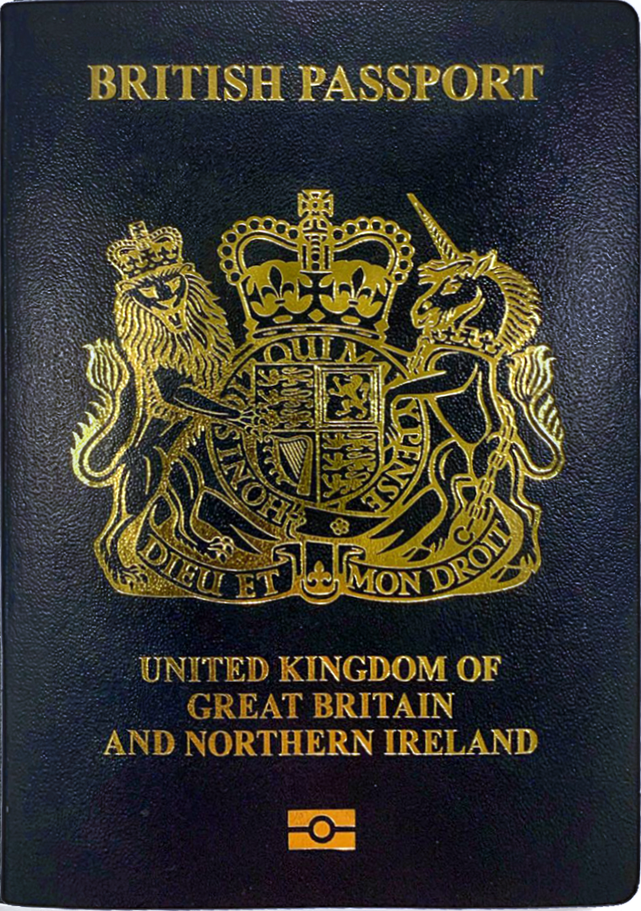

Who’s a Parent?
Notes:
Example taken from Wikipedia article on Algorithmic Bias.
https://en.wikipedia.org/wiki/British_passport#/media/File:British_passport_cover_2020.png
http://clipart-library.com/clipart/372048.htm

Slide 4


Different Kinds of Bias
Notes:
http://cliparts101.com/free_clipart/51879/Thinking
http://clipart-library.com/clipart/1402061.htm

Slide 5

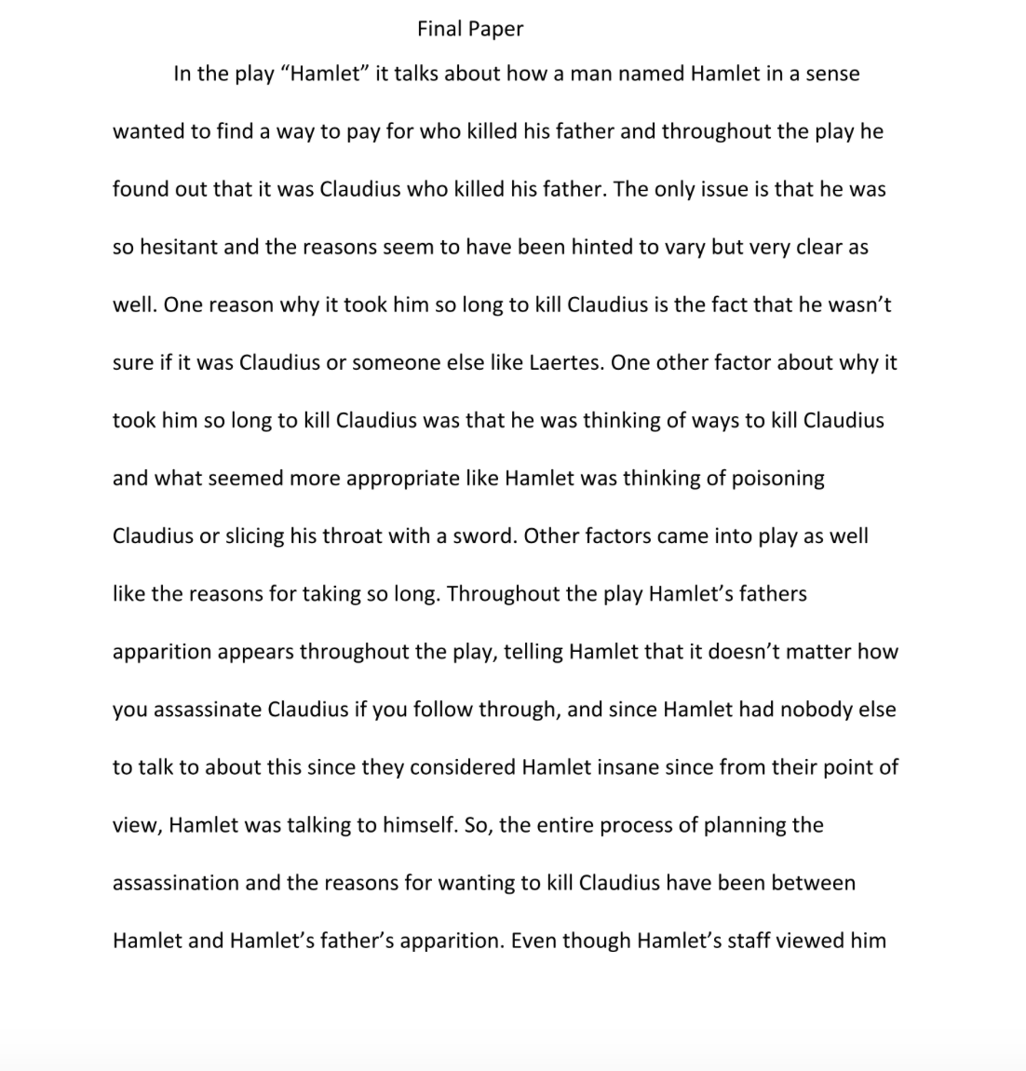
Who Cheats?
Notes:
Example from Wikipedia article on algorithmic bias
https://wordpress.clarku.edu/mat16-jlumsden/growth-in-student-learning/evidence/

Slide 6
Parole
Shoplifted $86.35 worth of tools from Home Depot.
Stole a child’s bike and scooter. Value $80. Dropped them and ran.
Convicted of armed robbery and attempted armed robbery, for which he served five years in prison, in addition to another armed robbery charge.
Misdemeanors committed while a juvenile.
Got it backward.
Notes:
http://www.nytimes.com/2016/06/26/opinion/sunday/artificial-intelligences-white-guy-problem.html?_r=0
https://www.propublica.org/article/machine-bias-risk-assessments-in-criminal-sentencing Yet Prater was the more seasoned criminal. And Borden did not reoffend. Prater did. Or at least one got caught and the other didn’t.

Slide 7
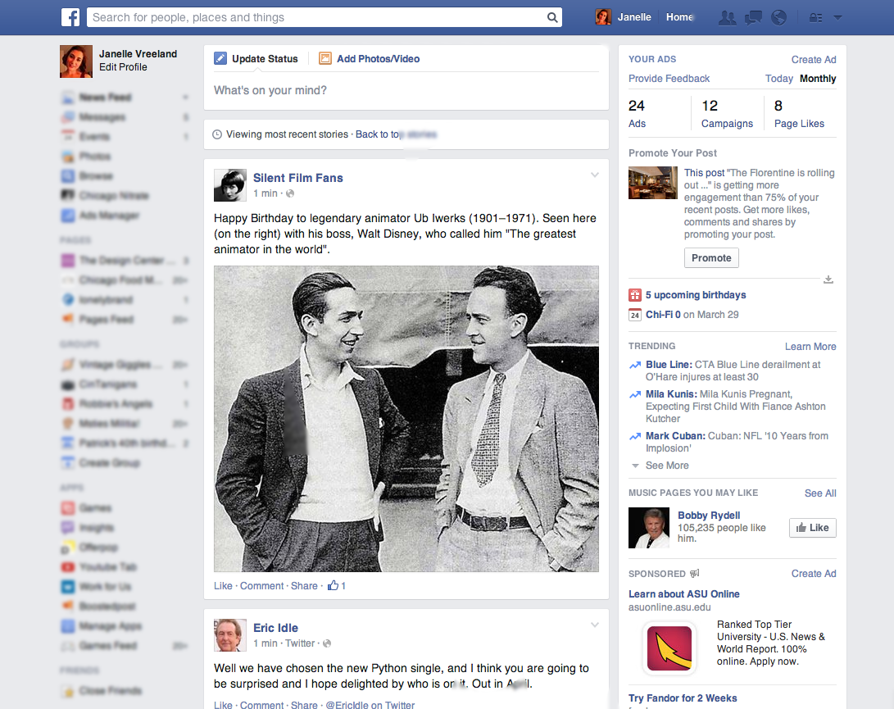
Algorithmic Bias – How Would We Know?
Notes:
Clicker question: Would it be ethical for Facebook to intentionally bias news in an attempt to influence an election? Ask students whether/how Facebook is different from MSNBC or Fox.
http://www.nytimes.com/2016/05/12/technology/facebooks-bias-is-built-in-and-bears-watching.html?_r=0
http://blog.storyful.com/2016/04/12/five-tips-for-improving-facebook-discovery/#.V9n575grI2w
http://www.youtube.com/watch?v=B8ofWFx525s
http://lonelybrand.com/blog/facebook-newsfeed-new-dimensions/

Slide 8



The Facebook News Feed Algorithm
Goal: Maximize engagement.
Joe Expert
Yesterday
Joe Cool Dude
Yesterday
The many differences between our coastal states and the central part of the country are complex in origin. Thus we shouldn’t be surprised that effective ways of bringing our country back together again will also be complex. We need to look carefully at economics, the formation …
We can always hope that California will simply fall into the ocean.
Notes:
What if they’re not trying to influence. But that comes as a consequence of another goaI?
I made up the text. But which of these is more likely to get liked and reposted? Which candidate will get more “feed time”?
https://www.theatlantic.com/technology/archive/2017/09/the-false-dream-of-a-neutral-facebook/541404/?google_editors_picks=true
https://www.iconfinder.com/icons/1321472/avatar_businessman_circle_human_male_person_user_icon
https://www.iconfinder.com/icons/1321470/avatar_circle_face_human_male_person_user_icon

Slide 9
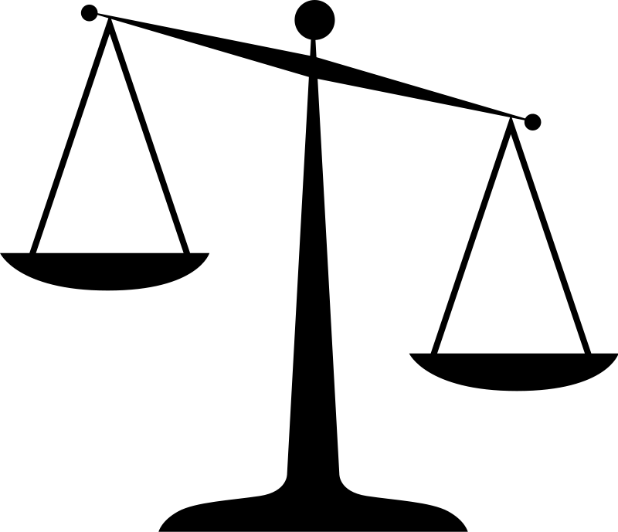
It’s Our Job to Watch for Bias
Notes:
http://clipart-library.com/clipart/8c6zERxcE.htm

